Slide 1
CHAPTER 08
Introduction to Transaction Processing Concepts and Theory

Slide 2
Introduction
Transaction
Describes local unit of database processing
Transaction processing systems
Systems with large databases and hundreds of concurrent users
Require high availability and fast response time

Slide 3
20.1 Introduction to Transaction Processing
Single-user DBMS
At most one user at a time can use the system
Example: home computer
Multiuser DBMS
Many users can access the system (database) concurrently
Example: airline reservations system

Slide 4
Introduction to Transaction Processing (cont’d.)
Multiprogramming
Allows operating system to execute multiple processes concurrently
Executes commands from one process, then suspends that process and executes commands from another process, etc.

Slide 5
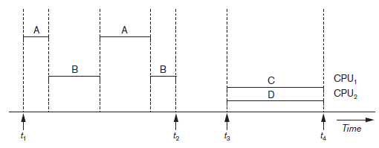
Introduction to Transaction Processing (cont’d.)
Interleaved processing
Parallel processing
Processes C and D in figure below
Figure 20.1 Interleaved processing versus parallel processing of concurrent transactions

Slide 6
Transactions
Transaction: an executing program
Forms logical unit of database processing
Begin and end transaction statements
Specify transaction boundaries
Read-only transaction
Read-write transaction

Slide 7
Database Items
Database represented as collection of named data items
Size of a data item called its granularity
Data item
Record
Disk block
Attribute value of a record
Transaction processing concepts independent of item granularity

Slide 8
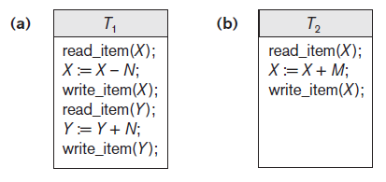
Read and Write Operations (cont’d.)
Read set of a transaction
Set of all items read
Write set of a transaction
Set of all items written
Figure 20.2 Two sample transactions (a) Transaction T1 (b) Transaction T2

Slide 9
Concurrency Control
Transactions submitted by various users may execute concurrently
Access and update the same database items
Some form of concurrency control is needed
The lost update problem
Occurs when two transactions that access the same database items have operations interleaved
Results in incorrect value of some database items

Slide 10
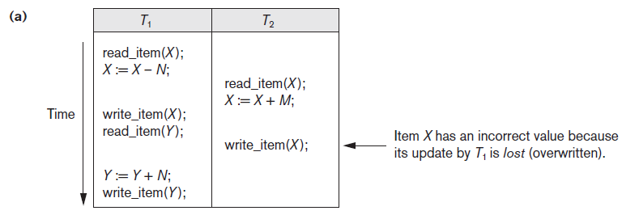
The Lost Update Problem
Figure 20.3 Some problems that occur when concurrent execution is uncontrolled (a) The lost update problem

Slide 11
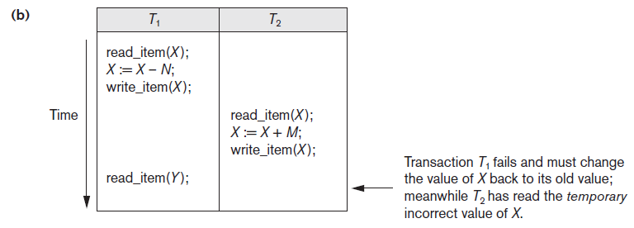
The Temporary Update Problem
Figure 20.3 (cont’d.) Some problems that occur when concurrent execution is uncontrolled (b) The temporary update problem

Slide 12
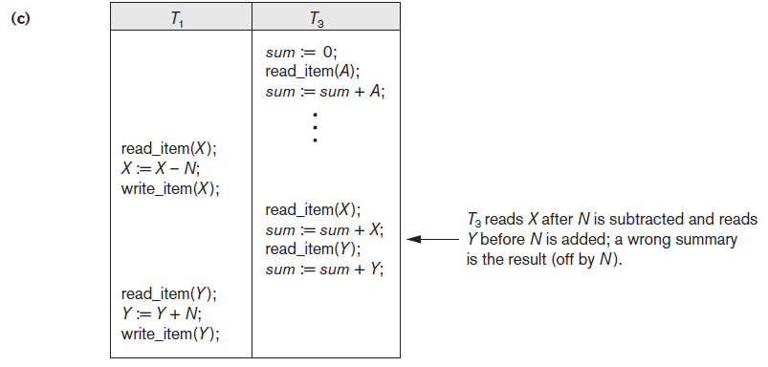
The Incorrect Summary Problem
Figure 20.3 (cont’d.) Some problems that occur when concurrent execution is uncontrolled (c) The incorrect summary problem

Slide 13
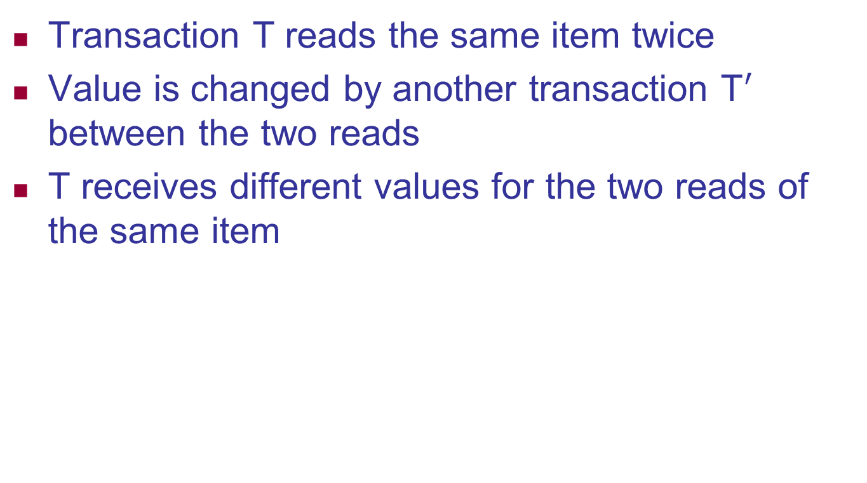
The Unrepeatable Read Problem
Transaction T reads the same item twice
Value is changed by another transaction T$′$ between the two reads
T receives different values for the two reads of the same item

Slide 14
Why Recovery is Needed
Committed transaction
Effect recorded permanently in the database
Aborted transaction
Does not affect the database
Types of transaction failures
Computer failure (system crash)
Transaction or system error
Local errors or exception conditions detected by the transaction

Slide 15
Why Recovery is Needed (cont’d.)
Types of transaction failures (cont’d.)
Concurrency control enforcement
Disk failure
Physical problems or catastrophes
System must keep sufficient information to recover quickly from the failure
Disk failure or other catastrophes have long recovery times

Slide 16
20.2 Transaction and System Concepts
System must keep track of when each transaction starts, terminates, commits, and/or aborts
BEGIN_TRANSACTION
READ or WRITE
END_TRANSACTION
COMMIT_TRANSACTION
ROLLBACK (or ABORT)

Slide 17
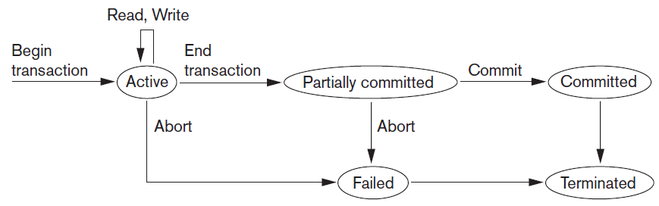
Transaction and System Concepts (cont’d.)
Figure 20.4 State transition diagram illustrating the states for transaction execution

Slide 18
The System Log
System log keeps track of transaction operations
Sequential
Not affected by failure (except disk or catastrophic failure)
Log buffer
Log file is backed up periodically
Undo and redo operations based on log possible

Slide 19
20.3 Desirable Properties of Transactions
ACID properties
Atomicity
Transaction performed in its entirety or not at all
Consistency preservation
Takes database from one consistent state to another
Isolation
Not interfered with by other transactions
Durability or permanency
Changes must persist in the database

